Slide 1



Department of Computer Science and Engineering
Optimized Cloud Security Framework Harnessing Hybrid Feature Selection and Machine Learning Classification for Intrusion Detection
Batch No: D 19
TEAM MEMBERS GUIDED BY
MALIREDDY SAI RAKESH - 211420104151 MRS C.JACKULIN,M.E
MANCHIGANTI DEERAJ SURYA – 211420104154
CHENNA REDDY PARITHRAAN - 211420104046

Slide 2
ABSTRACT
Cloud computing has become an integral part of modern IT infrastructure, offering scalability and flexibility. However, the increasing reliance on cloud services also attracts malicious activities and cyber threats.
In this context, an effective Intrusion Detection System (IDS) is crucial to safeguard cloud environments.
This paper presents an improved design for a Cloud Intrusion Detection System using a hybrid approach for feature selection and a machine learning classifier.
This system leverages label encoding, correlation analysis, and the Extra Tree algorithm to enhance the accuracy and efficiency of intrusion detection.

Slide 3
SCOPE
IDS is a detective device designed to detect malicious including policy-violating actions.
The scope for this project is to develop an intrusion detection system that will improve the security of home network as that is the potential user of this system.
The aim of this study is to enhance the efficacy of Cloud Intrusion Detection Systems by proposing an optimized design that integrates a hybrid feature selection approach with a machine learning classifier.
The system is designed to investigate the methods needed to detect any unauthorized access into a home networking system.
The proposed system leverages label encoding, correlation analysis, and the Extra Tree algorithm to enhance the accuracy and efficiency of intrusion detection.

Slide 4
OBJECTIVE
The Objective is to build a software system that allows user to detect the attack
This analysis aims to observe which features are most helpful in predicting the presence of the attack and also the type of attack.
The goal is to improve the accuracy and efficiency of intrusion detection in cloud environments, addressing the challenges posed by diverse feature types and ensuring robust protection against cyber threats
To develop an intrusion detection system for Windows-based Operating system.The system prevents abuse or overload from bandwidth and denial of Service attacks.
It monitors the traffic flow for any malicious activities of a network in real time.

Slide 5
LITERATURE SURVEY
S.NO | TITLE | CONTENT | AUTHOR | YEAR
1 | Intrusion Detection System Using machine learning Algorithm | The digital communication is very important in the human life. Without good network man cannot do their daily activities. The use of physical devices will be increased much in 2025. The occurrence of the intrusion is the very big problem when the communication happens. These problems should be overcome by using the ML algorithms. The effective digital communication helps to develop the business. The intrusion occurs in all types of networks which creates the serious problems in many areas. In this paper two ML algorithms are compared based on their performance. This comparison will help to develop the ensemble-based approach in future to achieve the highest performance and decrease in time. | A .Vinitha | 2023

Slide 6
LITERATURE SURVEY
S.NO | TITLE | CONTENT | AUTHOR | YEAR
2 | Efficient Intrusion Detection System in the Cloud Using Fusion Feature Selection Approaches and an Ensemble Classifier | The application of cloud computing has increased tremendously in both public and private organizations. However, attacks on cloud computing pose a serious threat to confidentiality and data integrity. Therefore, there is a need for a proper mechanism for detecting cloud intrusions. In this paper, we have proposed a cloud intrusion detection system (IDS) that is focused on boosting the classification accuracy by improving feature selection and weighing the ensemble model with the crow search algorithm (CSA). The feature selection is handled by combining both filter and automated models to obtain improved feature sets. The ensemble classifier is made up of machine and deep learning models such as long short-term memory (LSTM), support vector machine (SVM), XGBoost, and a fast learning network (FLN). The proposed ensemble model’s weights are generated with the CSA to obtain better prediction results. Experiments are executed on the NSL-KDD, Kyoto, and CSE-CIC-IDS-2018 datasets. | Mhamad Bakro , Rakesh Ranjan Kumar , Amerah A.Alabrah Zubair Ashraf Sukant K. Bisoy | 2023
6

Slide 7
Existing System
The Existing Cloud Intrusion Detection System makes use of
only synthetic minority over-sampling technique to address
the imbalanced data issue but fails to detect which of type of
attack.
The usage of algorithm that focuses on just data issues makes the system less efficient by not providing accurate details about the attack that took place.
The existing fails to process large volume of data and does not provide a robust define mechanism against the attacks which degrades the performance of the system
Overall,the existing system does not use much machine learning algorithms making the system prone to attacks.

Slide 8
DEMERITS
The Accuracy of system is low.
Does not process large volume of Data.
Performance time of system is high.
The system cannot detect the attack type.
The Implementation of the deployment process is not done.

Slide 9
PROPOSED SYSTEM
The Proposed System aims to enhance the efficiency and accuracy of the Cloud Intrusion Detection System by incorporating machine learning classifications
By integrating machine learning technique, the system can accurately process large volume of data and detect indicators of intrusion
The proposed system provides high accuracy,efficiency and detects which type of attack the data has gone through.
The machine learning techniques enhances the robustness of the feature selection process, ensuring that the selected features contribute significantly to the detection of intrusions.

Slide 10
MERITS
High accuracy and efficiency.
Ability to process large volume of data.
Detects the type of attack.
Increased Performance and less prediction time.
Developing a framework-based user-friendly application.

Slide 11
PROPOSED METHODOLOGY
The methodology used is Extra Tree classifier algorithm.
Extra Trees is an ensemble ML approach that trains numerous decision trees and aggregates the results from the group of decision trees to output a prediction.
the differences between Random Forest and Extra Trees, we see that Extra Trees have value, especially when computational cost is a concern.
Random Forest uses to select different variations of the training data to ensure decision trees are sufficiently different. However, Extra Trees uses the entire dataset to train decision trees.

Slide 12
PROPOSED METHODOLOGY
The detailed list of parameters for the Extra Trees Model are given below:
K - determines the strength of the attribute selection
process
nmin - the strength of averaging output noise
M - the strength of the variance reduction of the
ensemble model aggregation.
The parameter K, nmin and M have different effects.
Im
Extra tree
classifier
Import packages
Read Data
Data Validation

Slide 13
REQUIREMENTS
Software Requirements:
Operating System : Windows 10 (64 bit)
Software : Python 3.7
Tools : Anaconda (Jupyter Note Book)
Hardware Requirements:
Hard Disk : 500GB and Above
RAM : 4GB and Above
Processor : i3 and Above

Slide 14
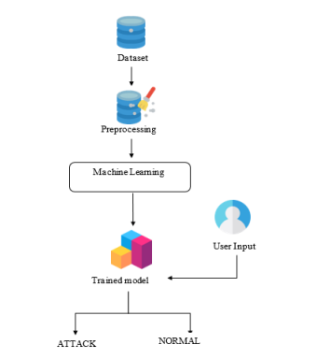
SYSTEM ARCHITECTURE

Slide 15

OUTPUTS

Slide 16
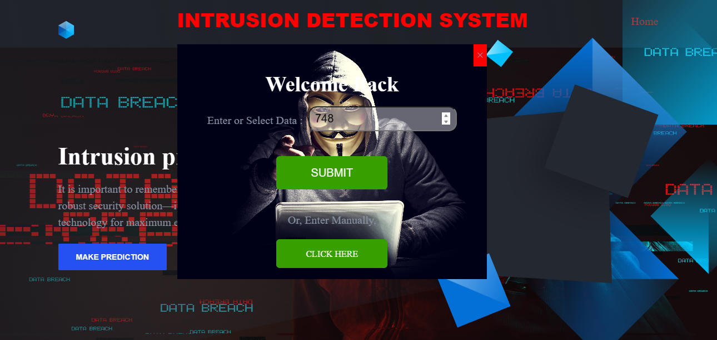
OUTPUTS

Slide 17
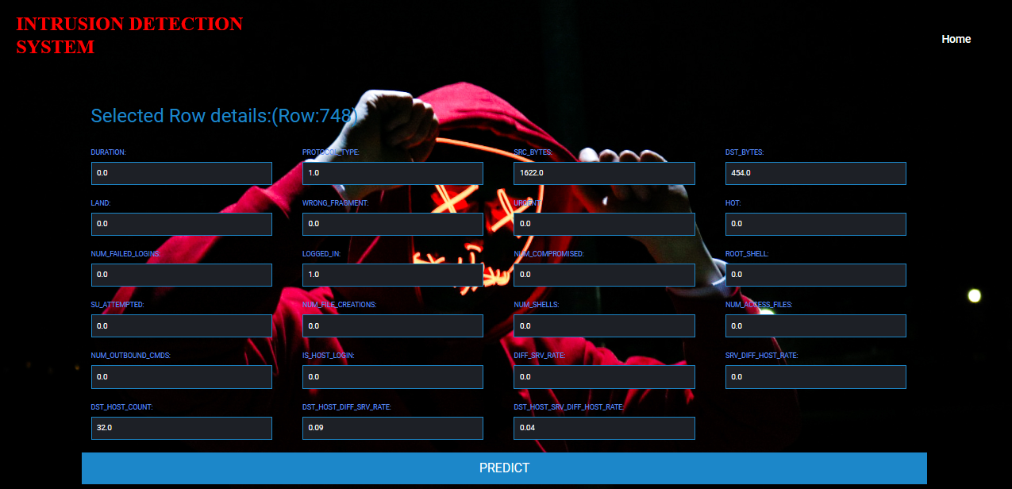
OUTPUTS

Slide 18

OUTPUTS

Slide 19

OUTPUTS

Slide 20

OUTPUTS

Slide 21

OUTPUTS

Slide 22
FUTURE ENHANCEMENT
To present a Prediction model with the aid of artificial Intelligence to improve over human accuracy and provide with the scope of early detection.
Cloud sector want to automate and detecting the attacks of transfers from eligibility process (real time) based on the connection detail.
To automate this process by show the prediction result in web application or desktop application at cloud.

Slide 23
REFERENCES
Mhamad Bakro, Rakesh Ranjan Kumar, Amerah Alabrah, Zubair Ashraf, Md Nadeem Ahmed,Mohammad Shameem, And Ahmed Abdelsalam, “An Improved Design for a Cloud IntrusionDetection System Using Hybrid Features Selection Approach With ML Classifier”, IEEE, 26 June2023.
M. Bakro, R. R. Kumar, S. K. Bisoy, M. O. Addas, and D. Khamis, ‘‘Developing a cloud intrusion detection system with filter-based features selection techniques and SVM classifier,’’ in Proc. Int. Conf. Comput., Commun. Learn., vol. 1729. Cham, Switzerland: Springer, 2023, pp.15–26, doi:10.1007/978-3-031-21750-0_2.
M. Bakro, R. R. Kumar, A. A. Alabrah, Z. Ashraf, S. K. Bisoy, N. Parveen, S. Khawatmi, andA. Abdelsalam, ‘‘Efficient intrusion detection system in the cloud using fusion feature selection approaches and an ensemble classifier,’’ Electronics, vol. 12, no. 11, p. 2427, May 2023,doi:10.3390/electronics12112427.
R. R. Kumar, A. Tomar, M. Shameem, and M. N. Alam, ‘‘OPTCLOUD: An optimal cloud service selection framework using QoS correlation lens,’’ Comput. Intell. Neurosci., vol. 2022, pp. 1–16, May 2022, doi: 10.1155/2022/2019485.
R. R. Kumar, M. Shameem, and C. Kumar, ‘‘A computational framework for ranking prediction of cloud services under fuzzy environment,’’Enterprise Inf. Syst., vol. 16, no. 1, pp. 167–187, Jan. 2022, doi: 10.1080/17517575.2021.1889037.
M. Bakro, S. K. Bisoy, A. K. Patel, and M. A. Naal, ‘‘Hybrid blockchain enabled security in cloud storage infrastructure using ECC and AES algorithms,’’ in Blockchain based Internet of Things. Singapore: Springer, 2022, pp. 139–170, doi: 10.1007/978-981-16-9260-4_6.

Slide 24

THANK YOU

